Slide 1
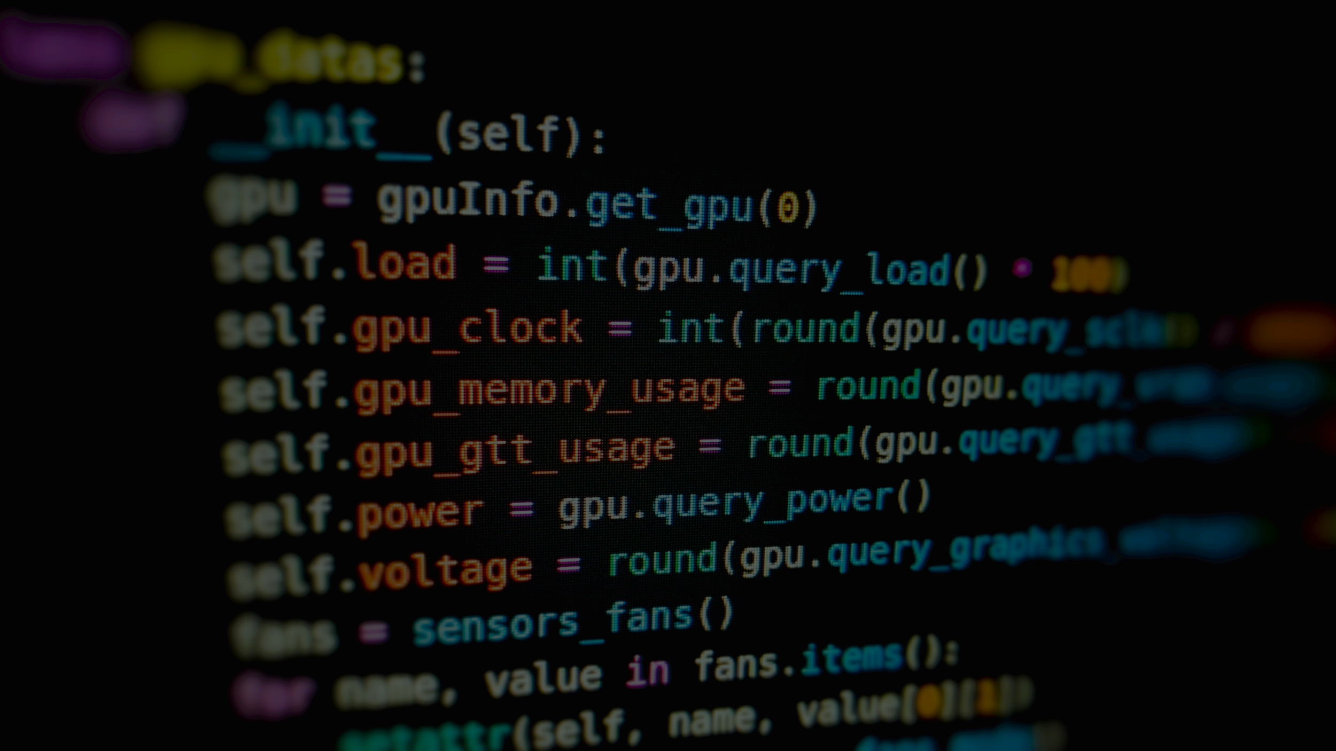
Image Processing with Python
Ryan He

Slide 2
Table of contents
Why I learned Image processing
Setup and basic code
Pixel replacement
Image stacking
Cascadia project

Slide 3
Why I learned image processing

Slide 4
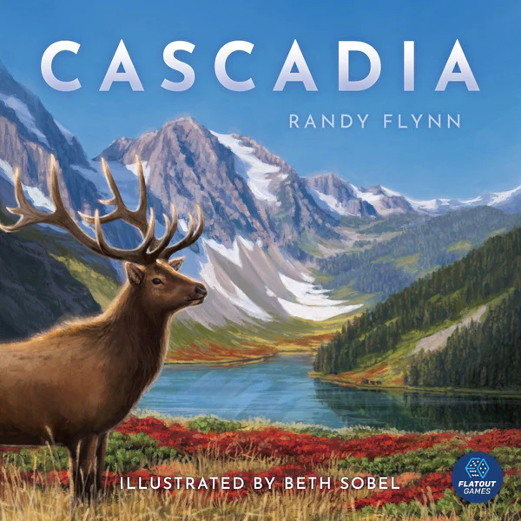
What got me into learning image processing
We have a project for CS3 where we had to program the game Cascadia, my group wanted high quality images for the game pieces

Slide 5
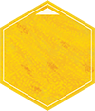
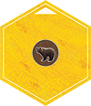

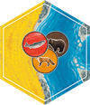
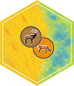
What got me into learning image processing
What we have
What we want
We searched online and couldn’t find images of these pieces, instead, we found images of landmass tiles (hexagon) and images of animal tokens (circle animal).
We also had to make images like these, in total we needed to make 95 images.
Using python means an increased level of efficiency and precision

Slide 6
2. Setup and basic code

Slide 7
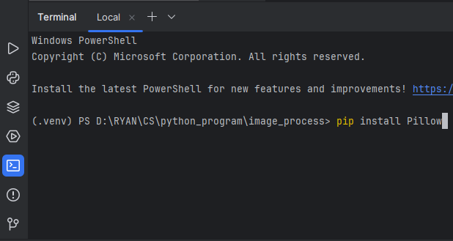
Setting up (Python + Library)
Download python
Go to terminal on your IDE and install Pillow with pip install

Slide 8
Basic code
Import: from PIL import Image
Open: my_image = Image.open(‘image.png’)
Convert: my_image = my_image.convert(‘RGBA’)
Resize: my_image.resize(width, height);
Save: my_image.save(‘my_image.png’)
Close: my_image.close()

Slide 9
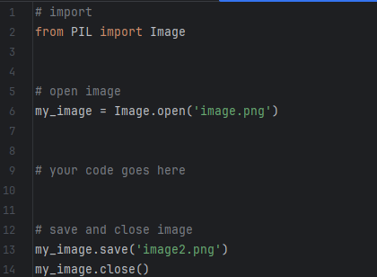
Program outline
You code will most likely look something like this

Slide 10
3. Pixel replacement

Slide 11
Pixel replacement
Pixel replacement is very useful in a lot of cases. For example, it can be used to accomplish tasks such as removing background of certain images, or replacing colors of certain parts of images

Slide 12
load() function
# import
from PIL import Image
# open image
image = Image.open('image.png')
# load pixel data
pixels = image.load()
# access pixel at coordinates (x, y) ((0, 0) is top left)
pixel = pixels[x,y]
print(pixel)
# close image
image.close()
load() function loads pixel data from image, and it is very useful for pixel replacement, since it allows you to directly manipulate pixel data
Demo code is shown on the right

Slide 13
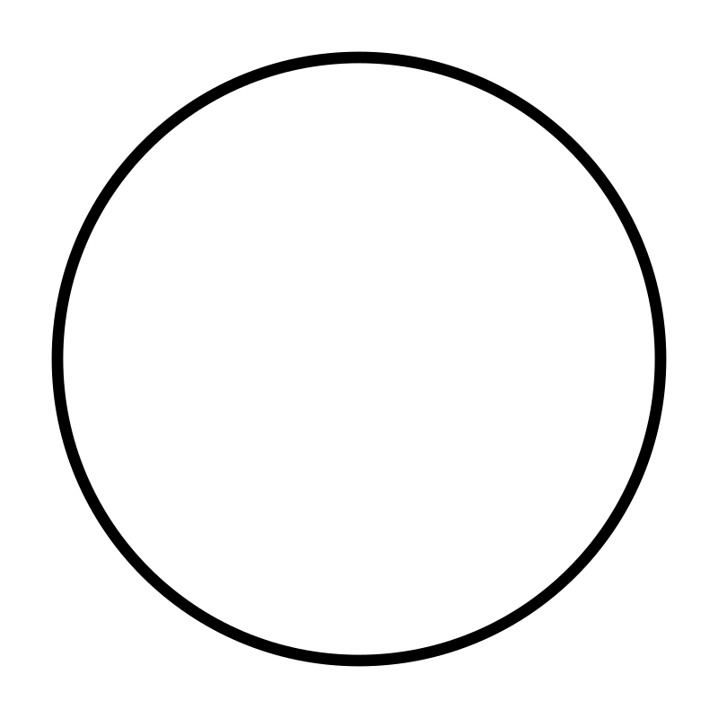
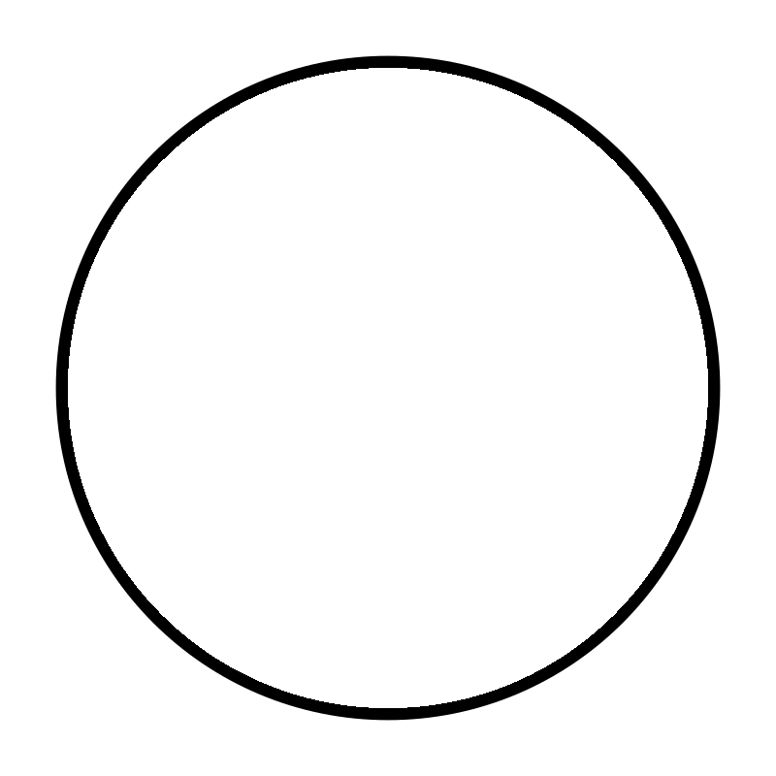
Background removal
# import
from PIL import Image
# open image
circle_img = Image.open('img/circle.png')
# convert image
circle_img = circle_img.convert('RGBA')
# load pixel data
pixels = circle_img.load()
# iterate through the image to remove background
for i in range(circle_img.width):
for j in range(circle_img.height):
# if current pixel is white, change it to transparent
r, g, b, a = pixels[i, j]
if r > 0:
# replace with transparent pixel
pixels[i, j] = (0, 0, 0, 0)
# save
circle_img.save('img/circle_bg.png')
# close
circle_img.close()
Suppose we have an image of a circle, whose background is white, but we want to make it transparent.
We can iterate through all the pixels, and if a pixel’s rgb value is (255, 255, 255) (white), then we replace that pixel with a transparent pixel

Slide 14
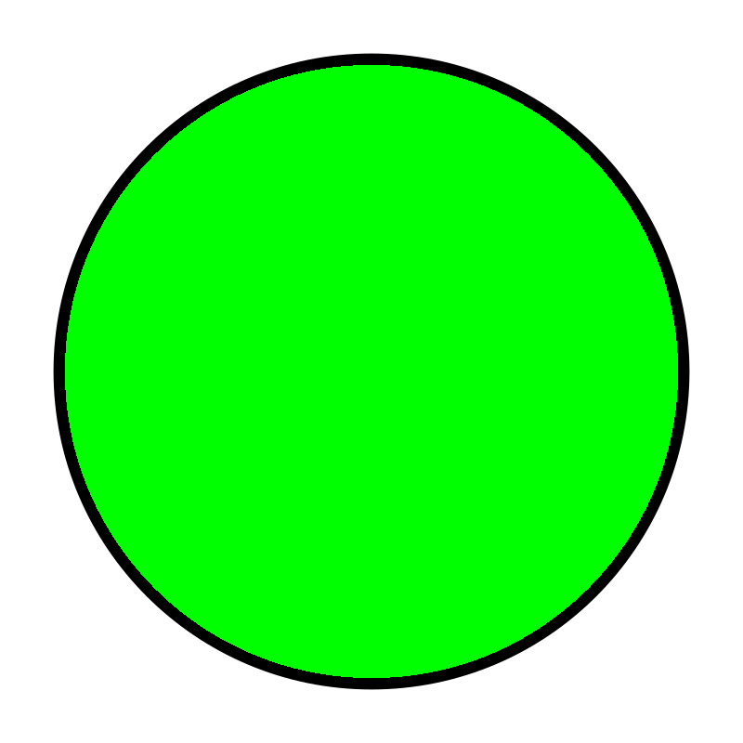
Change color
# import
from PIL import Image
# open image
circle_img = Image.open('img/circle.png')
# convert image
circle_img = circle_img.convert('RGBA')
# load pixel data
pixels = circle_img.load()
# iterate through the image to change white pixels to green
for i in range(circle_img.width):
for j in range(circle_img.height):
# if current pixel is white, change it to green
r, g, b, a = pixels[i, j]
if r > 0:
# replace with green pixel
pixels[i, j] = (0, 255, 0, 255)
# save
circle_img.save('img/circle_green.png')
# close
circle_img.close()
Changing colors of an image follows a similar idea, where you iterate through the image and replace target rgb value pixels to the rgb value you want
In this case, the demo code replaces white pixels with green pixels in the circle image

Slide 15
4. Image stacking

Slide 16
paste()
The paste() method is a method that allows an image to be pasted on another.
image1.paste(image2, (x, y)) means that image2 is pasted on image1 at the (x, y) coordinate
If image2 has transparent pixels and you want them transparent, use
image1.paste(image2, (x, y), image2) instead

Slide 17
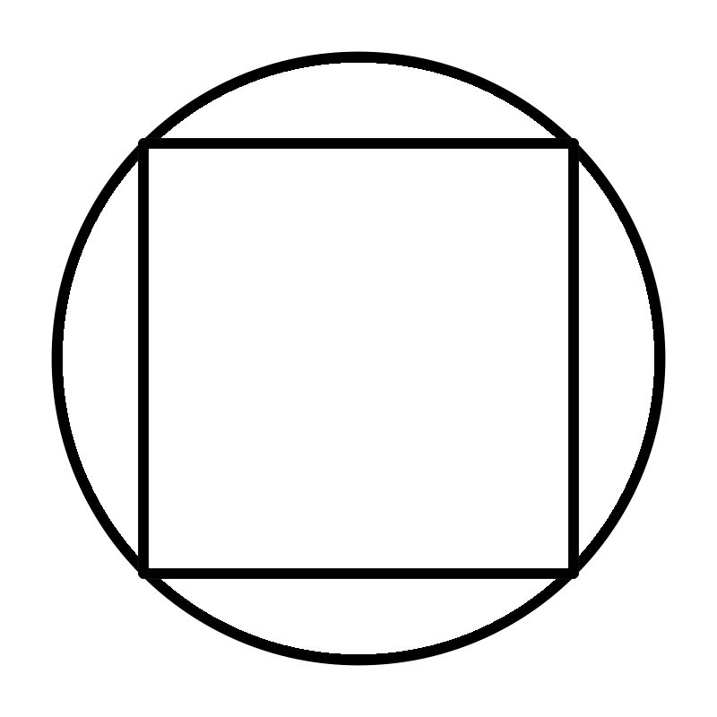
Stack
from PIL import Image
square_image = Image.open('img/square_bg.png')
circle_image = Image.open('img/circle_bg.png').convert('RGBA')
# resize square image
square_image = square_image.resize((circle_image.width, circle_image.height))
# put square on the middle circle image
circle_image.paste(square_image, (0, 0), square_image)
# save image
circle_image.save('img/circle+square.png')
# close images
circle_image.close()
square_image.close()
Here’s a demo code for stacking a square on a circle

Slide 18
4. Cascadia

Slide 19
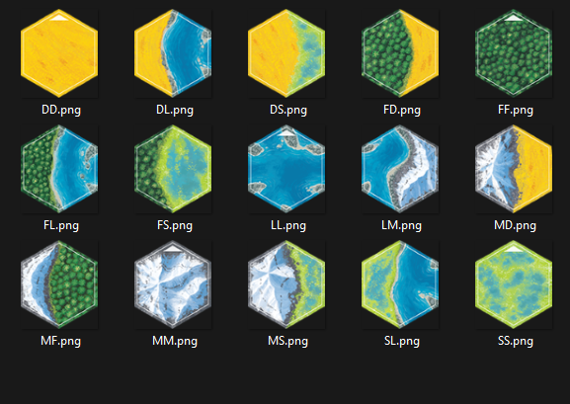
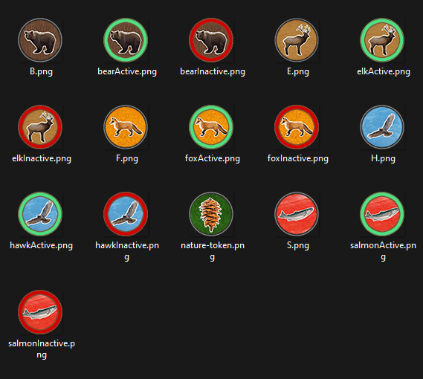
Naming
I renamed all of the landmass and animal token images

Slide 20
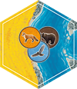
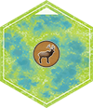
Txt file
Then I put all the names of the tiles required in a txt file, in the format of LL-AAA (L for land and A for animal)
For example, DL-FHB would be this image shown below
For images that have only one animal, the animal part of the name would only be one letter long
For example, the image below would be named as SS-E

Slide 21
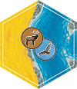
Code
I then wrote a python program that reads the text file for each tile image’s name. Through the name, the program takes the corresponding landmass image and the animal token images, and put the animal token images on the landmass image based on the number of animal tokens the tile has and format required
1 token tile format 2 token tile format 3 token tile format

Slide 22
Thank you for listening
https://github.com/RyanHee/image_process

